Slide 1
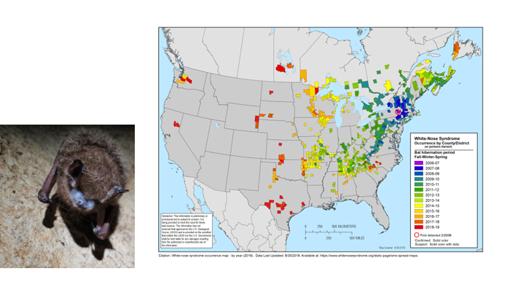
Bats are Important but Declining in
North America
Bats make up 20%-25% of mammalian species
  They live on all continents except Antarctica
  Over 1,400 species worldwide
  Only mammal that can truly fly
Loss of bats is projected to lead to agricultural costs of more than $3.7 billion/year* because of pest control
  Bats pollinate and spread seeds of fruits like bananas, avocados and mangos
A healthy bat population is a sign of a healthy ecosystem
  As our mammalian relatives they are our “canary in a coal mine”
  Recent declines in bat populations nationally
White-nose syndrome (>6MM killed since 2007)
  Fungal disease with ideal growth conditions in caves
  Causes wing damage, and overuse of energy
  Large losses of Little Brown and Tri-colored bats in VA
Wind turbine related fatalities
*Economic Importance of Bats in Agriculture.
Boyles et. al. Science Vol 332, April 2011

Slide 2
Bats in North America and Virginia
45 species of bats are found in North America
17 species have been documented in Virginia
Two Types of Bats
  Megachiroptera – Large (6 ft wing-span) Fruit eating, mostly in Asia and Southwest Pacific
  Microchiroptera – Small (<2 ft wing-span) Insectivores, large ears, most North American bats
Microchiroptera
  Most use echolocation to find their prey
  Can eat up to 3,000 insects in a single night
  Cave vs Tree bats
    Cave bats hibernate in caves during the winter and typically have a single pup in a year
    Tree bats hibernate in tree cavities and bear multiple pups per year
    During summer months cave bats can also use trees or buildings as roosts
Information from “A Guide to Bats in Virginia” Virginia Department of Wildlife Resources

Slide 3
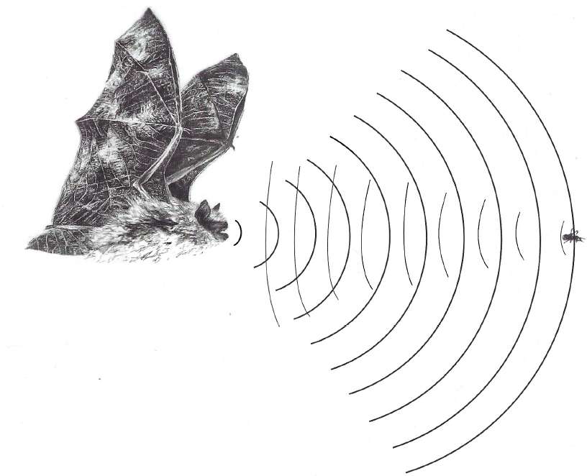
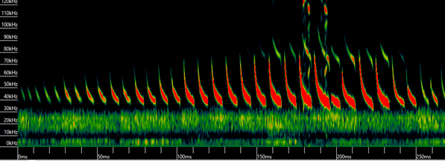
Bat Echolocation is a Navigation and Hunting Tool
Microchiroptera bats use echolocation to navigate and find food.
Different bat species use different types of echolocation calls.
Echolocation calls are ultrasonic sounds that are usually too high for humans to hear.
Recording echolocation calls is a good way to identify bat species in an area
Software can be used to automatically identify species from bat recordings
Not all recordings can be assigned a species ID
Little Brown Bat Echolocation Recording

Slide 4
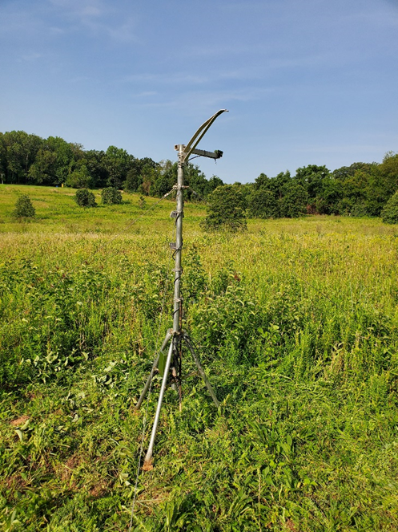
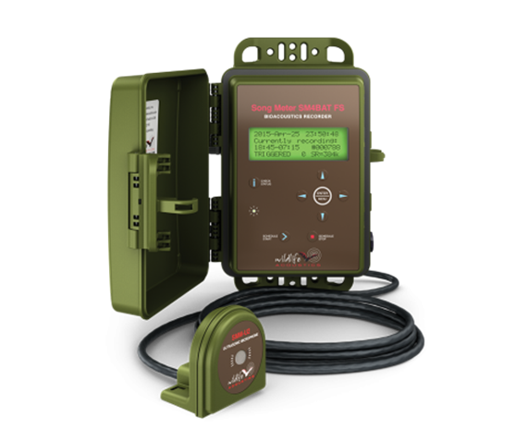
A Decade Long Project to Monitor Bats in Loudoun County
Contribute to the international North American Bat Monitoring Program (NABat) efforts of the USGS
Adds a rich data resource for monitoring the health of the county ecosystem
  Similar in scope to bird counts performed in the county
  Better understanding of bat’s role in the county
  Monitor for changes in bat activity over time
Cover four NABat 100 km² grid locations
  Banshee Reeks containing grid
  Leesburg containing grid
  Northern Loudoun grid
  Blue Ridge Center For Environmental Stewardship
Deploy 13 stationary acoustic monitoring rigs (April-October)
Automatically ID bat species from recordings using commercially available software

Slide 5
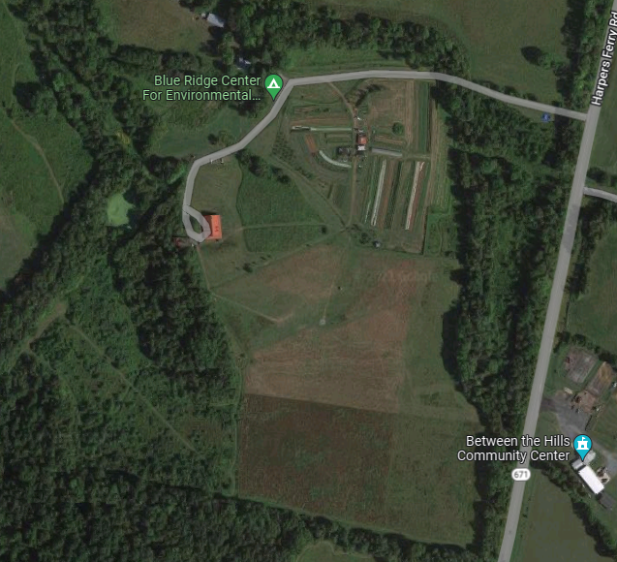
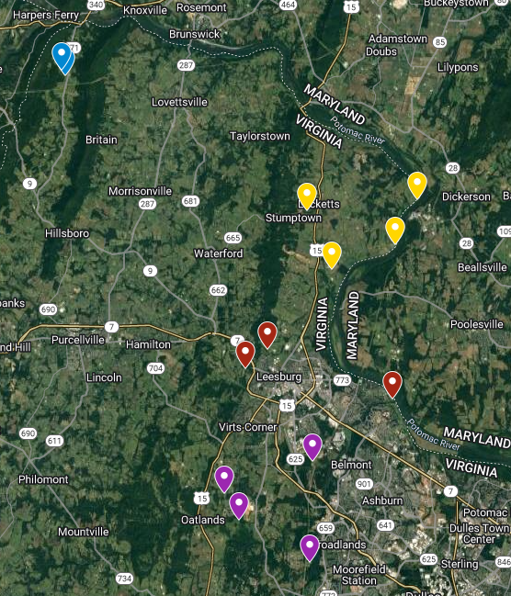
Loudoun County
Monitoring Locations
Blue Ridge Center for Environmental Stewardship
JK Black Oak
Temple Hall Farm
Lost Corner Farm
Riverside at the Potomac
River Creek
Morven Park
Rust Sanctuary
Banshee Reeks Nature Preserve
Beaver Dam
Little Tree Huggers
Philip Bolen

Slide 6
9 of 17 VA Bats Observed In Loudoun County
Bats Observed in Loudoun County
Bats Unlikely in Loudoun County
Big Brown
Eastern Red
Evening
Free Tailed – Previously seen in Southern VA
Hoary
Little Brown – Rare because of White-nose syndrome
Northern Long-eared – One observation at Blue Ridge Center
Silver Haired
Tri-colored
Southeastern
Gray
Eastern Small-footed
Indiana
Northern Yellow
Seminole
Rafinesque’s Big-eared
Virginia Big-eared
Bats observed with 100% likelihood
Bats observed but physical confirmation may be required for absolute proof

Slide 7
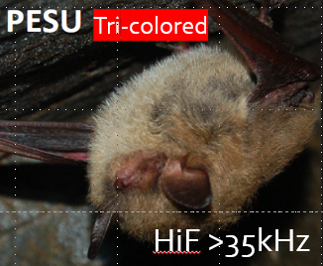
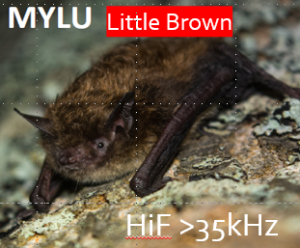
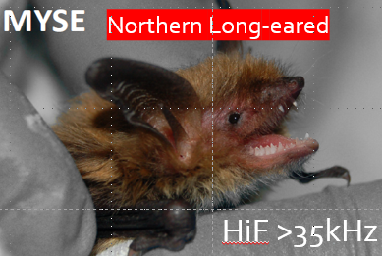
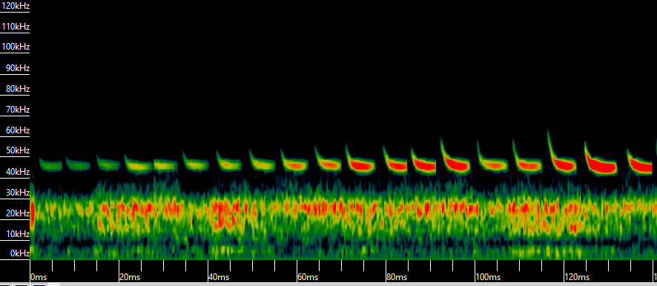
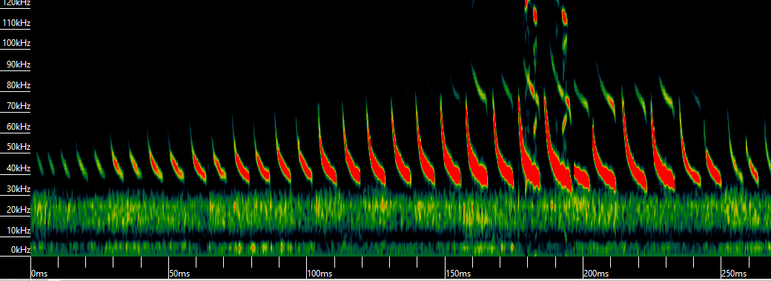
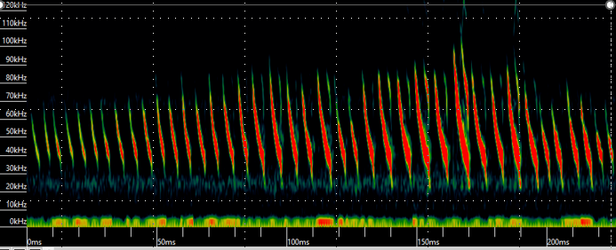
Daily Presence of Bats at Blue Ridge Center for Environmental Stewardship

Slide 8
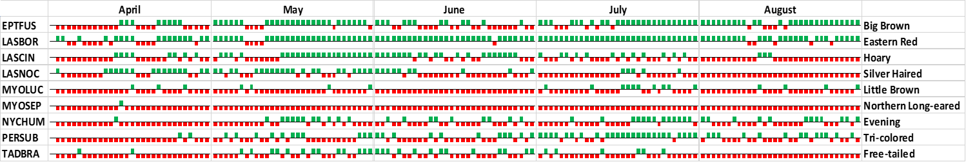
Day by Day Presence of Bats at Blue Ridge Center, Rigs 1 &2
Present
Absent

